Slide 1


Slide 2
#F9402B
#F66B2B
#F99C35
#FFDE37
#C7DC51
#7CD046
#FD3769
#F04496
#8048A3
#4E60B4
#00C2FF
#009AD8

Slide 3




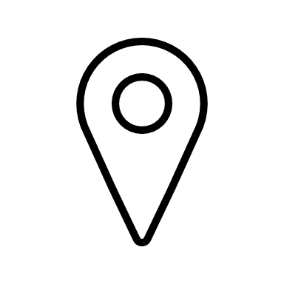



Slide 4






Slide 5
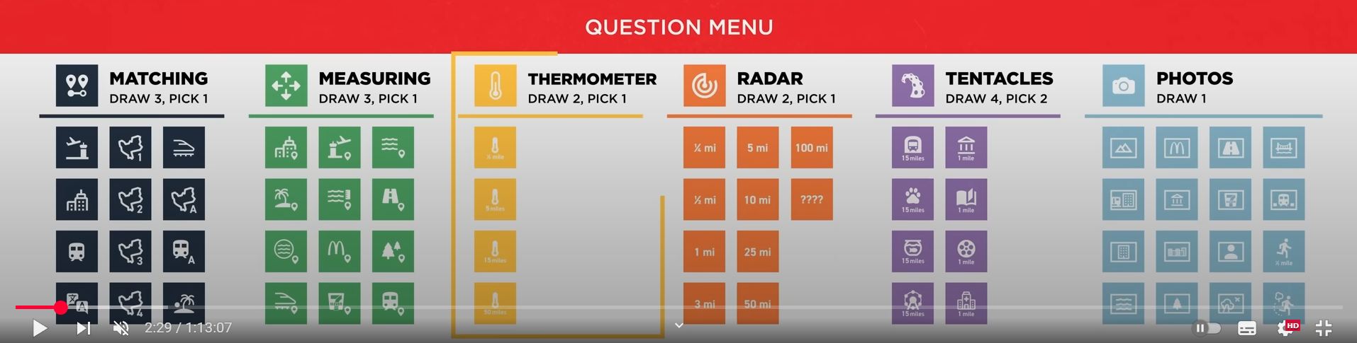


Is your nearest […] the same as mine?
Suburb
Water body
(Maas, Kralingse Plas, …)
A-road
(A20, A15, …)
Train station
Metro station
Tram station
Compared to me, are you closer to or further from a […]?
Church
School
Museum
Supermarket
School
Church
I’ve just travelled (at least) […]. Am I hotter or colder?
2 km
1 km
500 m
Are you within a distance of […] from me?
5 km
2 km
1 km
500 m
250 m
Send a photo of […]
A bridge
A road
A supermarket
A snack bar
A museum
A school
The tallest building you can see
The largest body of water that you can see
A 500 m strava route

Slide 6





Suburb
Train Station
Church
Supermarket
Water Body
Metro Station
School
Cinema
A-road
Tram Station
Museum

Slide 7

2 km
2 km
250 m
1 km
1 km
100 m
500 m
500 m
Tram Station
A-road

Slide 8



Strava Route
High Building
Large Bridge

Slide 9



Slide 10


Slide 11
